Slide 1
ABUSING ELECTRON APPLICATIONS
Here is where your presentation begins
By: Fletcher Davis

Slide 2

WHOAMI
Fletcher Davis (@gymR4T)
Senior Red Team Consultant at CrowdStrike
Specializing in Adversary Simulation and Offensive Security Research
Previously:
Red Team Consultant at Mandiant
Cyber Security Engineering Student at George Mason University

Slide 3
The research expressed here is mine alone and is not necessarily representative of the views of my employers

Slide 4

GOALS
Identify alternative way to execute code and perform post-exploitation on compromised machine
Abuse Electron’s architectural design to modify production application source code
Leverage Foreign Function Interfaces to execute shellcode in-memory

Slide 5
(PERIODIC) TABLE OF CONTENTS
01
02
BACKGROUND
ASAR HIJACKING
03
04
SHELLCODE LOADER
CONCLUSION
Introduction to Electron
Modify Production Electron Apps to Run Code
Abuse FFI to Execute Code In-Process
Conclusion and Recommendations

Slide 6
01
BACKGROUND
Introduction to Electron

Slide 7

WHAT IS ELECTRON?
Electron is a runtime framework for developing cross-platform desktop applications with JavaScript, HTML, and CSS
Electron consists of three components
Chromium’s Rendering Library
Node.js
C++

Slide 8
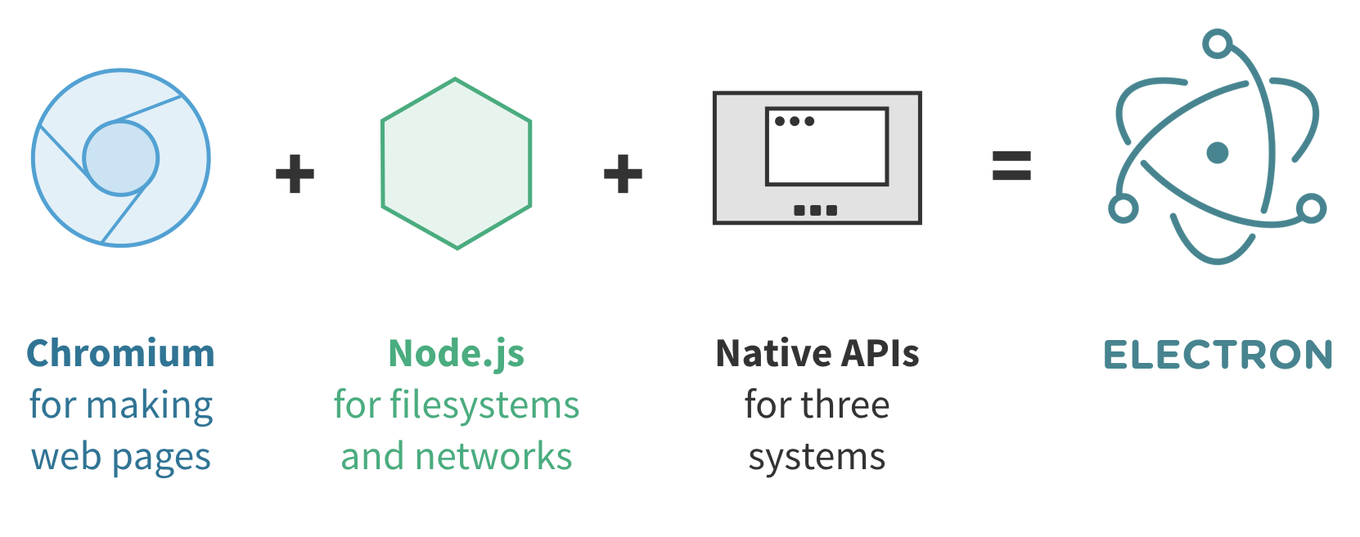
ELECTRON COMPONENTS
Chromium’s Rendering Library
Open-Source foundation for Google’s browser Chrome
Node.js
JavaScript runtime built on top of Google’s V8 JavaScript engine
Provides access to open-source NPM modules
C++
Extending APIs for common operating system operations

Slide 9
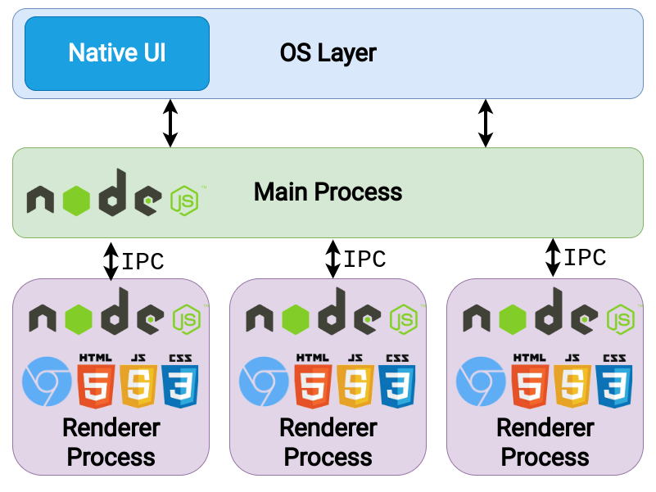
ELECTRON PROCESS MODEL
Electron inherits a multi-process architecture from Chromium
Main Process
Electron app has one main process
Runs in a Node.js environment
Native APIs extend Electron to allow interaction with operating system
Renderer Process
Renders web content for Electron app
No direct access to some Electron APIs

Slide 10







WHO USES ELECTRON?
Slack
Visual Studio Code
Obsidian
Microsoft Teams
WhatsApp
Skype
Discord
Signal

Slide 11
02
ASAR HIJACKING
Modify Production Electron Apps to Run Code

Slide 12
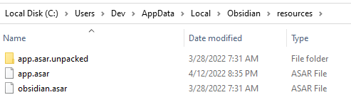
WHAT IS AN ASAR FILE?
ASAR is a simple extensive archive format
Similar to tar where all files are concatenated together, but without the compression
App.asar file contains application source code
Electron architecture exposes ASAR files in application’s installation folder
On Windows, several applications store these files in %LOCALAPPDATA%

Slide 13
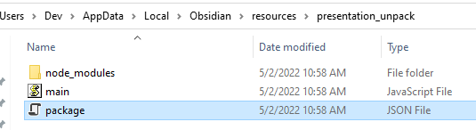
ASAR FILE CONTENTS
App.asar contains (at a minimum):
Package.json
Entry Point JavaScript file (main.js)
Node Modules (node_modules)
Contents are not encrypted, obfuscated, or protected
A user can make modifications to these files, and re-pack the file without modifying the signature of the actual executable

Slide 14
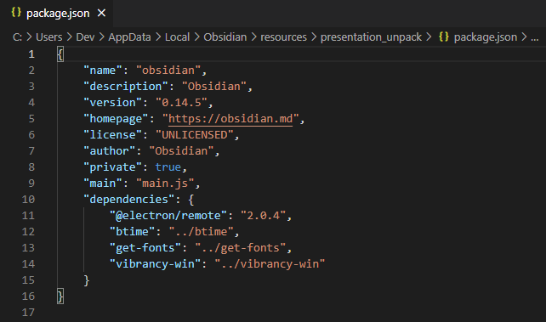
PACKAGE.JSON
Package.json is the manifest for the application
Contains properties about application
Important properties:
Name: Sets application’s name
Main: Sets the entry point for the application
Dependencies: Sets a list of npm packages installed as dependencies

Slide 15
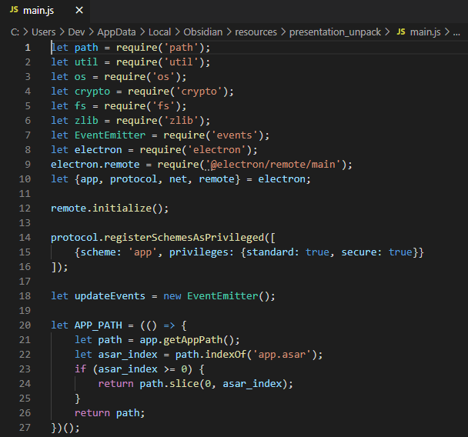
APPLICATION ENTRY POINT
The application’s entry point contains the Main Process code
The package.json manifest sets the application’s entry point
Some applications, like Slack, minify and obfuscate the application’s source code
Ex. Slack uses Webpack to bundle
Might involve additional steps to view and modify

Slide 16
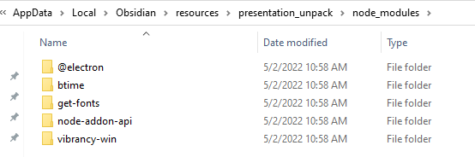
NODE MODULES
Modules are a set of functions you want to include in your application
Node/Electron have a set of built-in modules that don’t require further installation
The node_modules folder stores external modules that are used by an application
Once a module is locally stored, you can use require(“packagename”) to load it

Slide 17
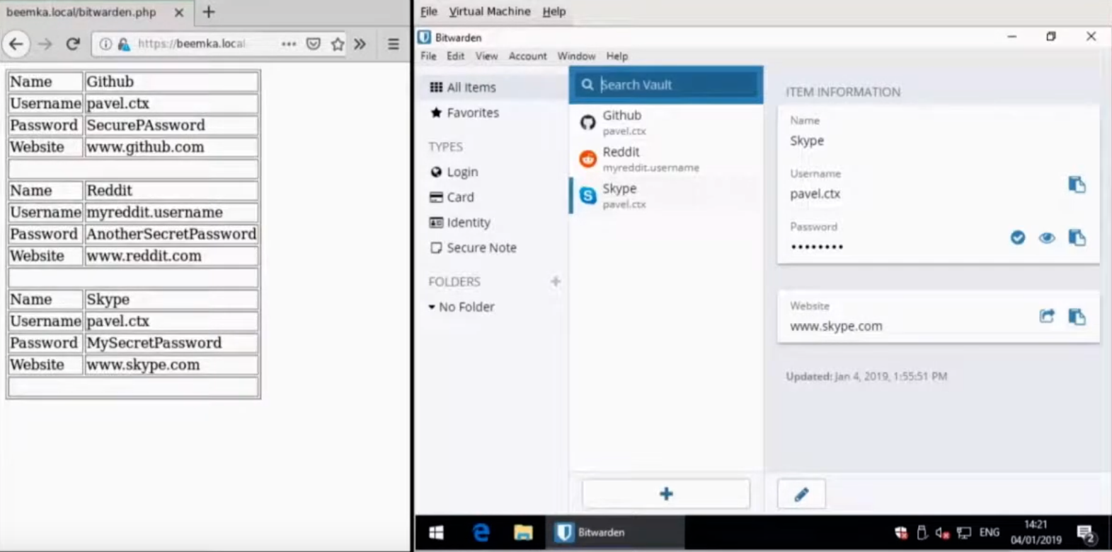
ASAR HIJACKING
Discovered by Pavel Tsakalidis of Context Information Security
Presented research at BSidesLV 2019
Published open-source tool BEEMKA to automate backdooring of Electron applications

Slide 18

ASAR BACKDOORING PROCESS
Unpack the app.asar file using asar module
Modify entry point JavaScript file
If additional libraries are used, update package.json and add modules to node_modules
Pack the contents back into app.asar
Place app.asar in correct directory (typically in /resources/*)

Slide 19
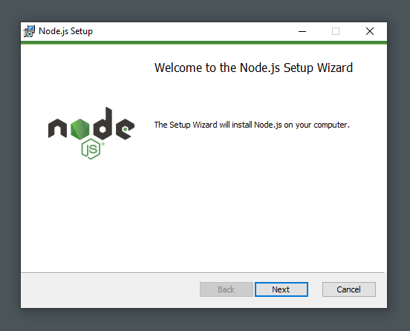
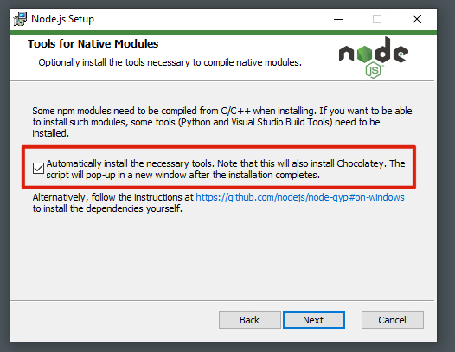
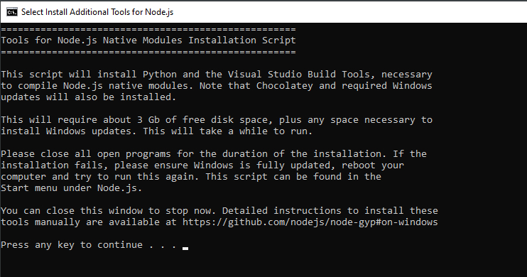
Install Node.js + Native Modules
https://nodejs.org/en/download/

Slide 20
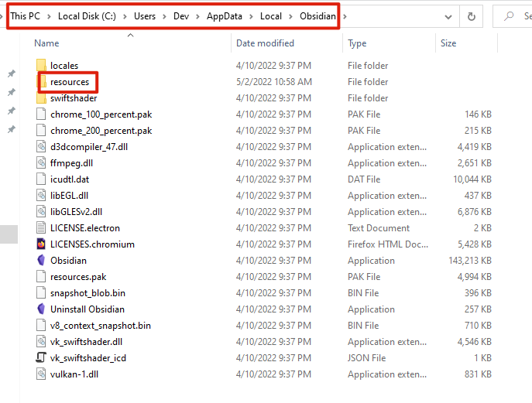
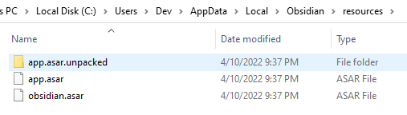
Identify Application Installation Folder

Slide 21
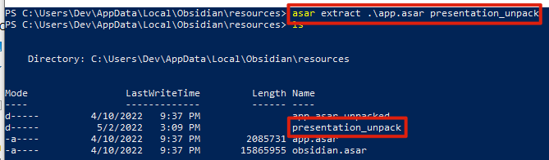
Unpack app.asar using ASAR module
Note: If you perform unpacking and backdooring off host, you must download app.asar and app.asar.unpacked

Slide 22
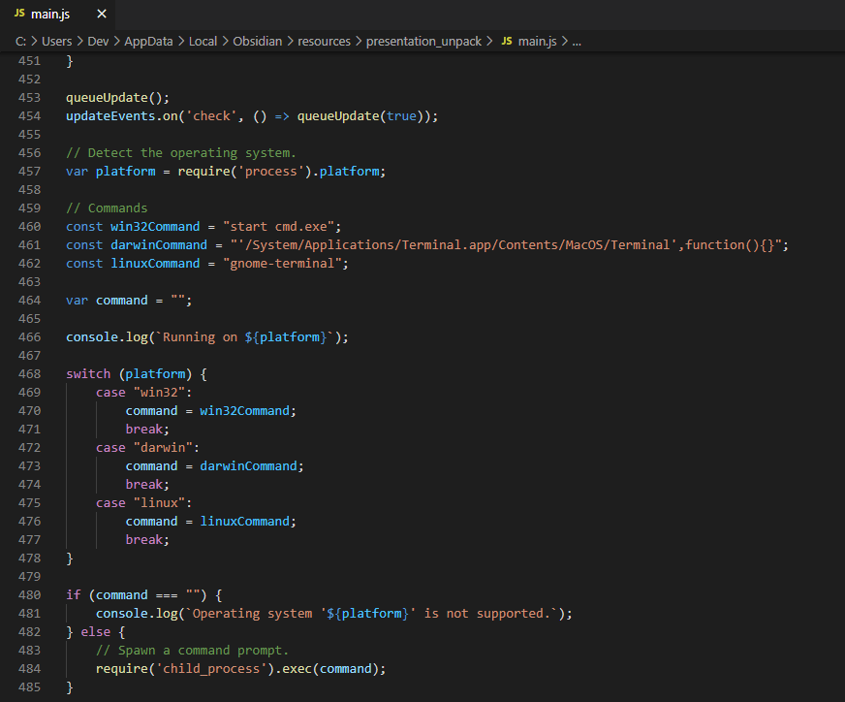
Modify Entry Point JavaScript file
Identifies OS Type
Platform-dependent command
Spawns Child Process

Slide 23
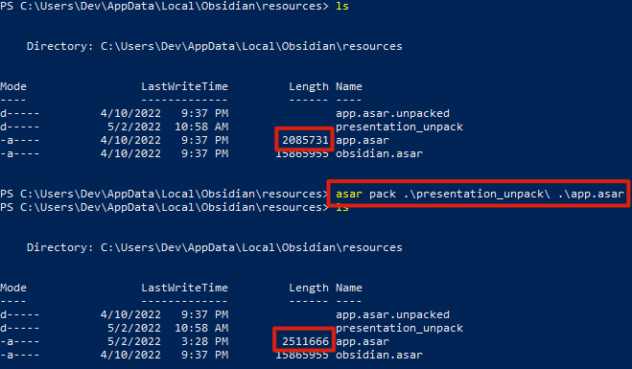
Pack app.asar using ASAR module

Slide 24
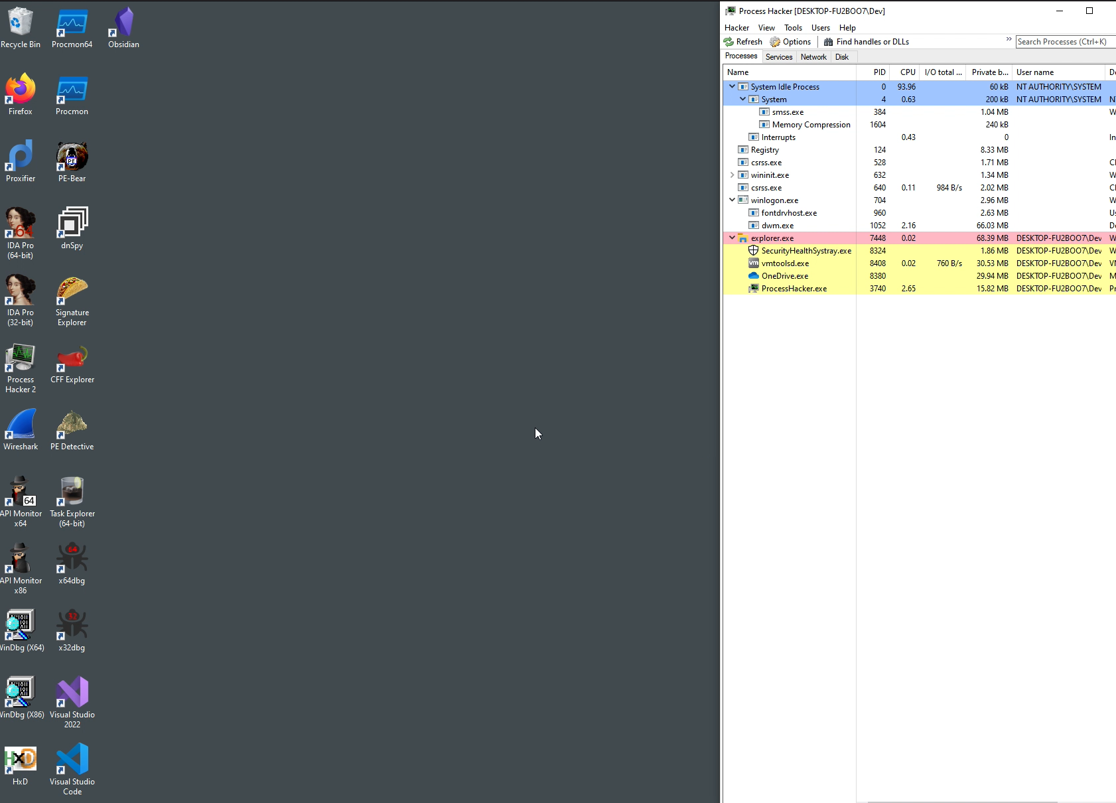
Demo

Slide 25
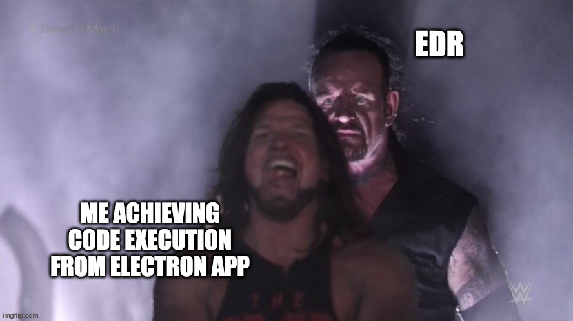
ASAR BACKDOORING RESULTS
Pros:
Execute backdoor code from production Electron application
Only requires low-privilege access
Cons:
Parent/Child Process relationship would get flagged by commercial EDRs

Slide 26
03
SHELLCODE LOADER
Abuse FFI to Execute to Code In-Process

Slide 27
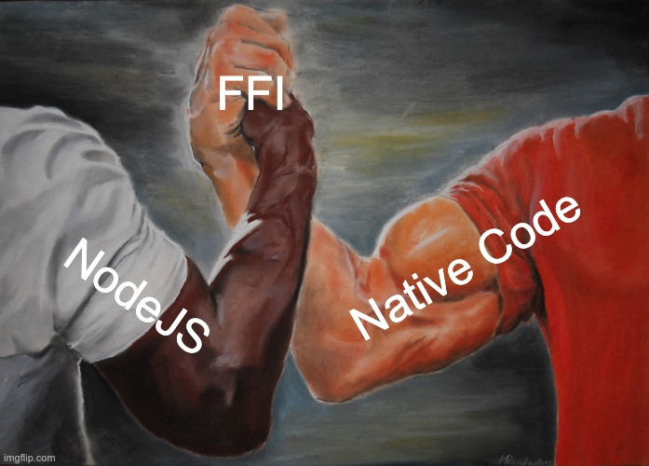
INTRODUCING FOREIGN FUNCTION INTERFACE
Foreign Function Interface (FFI) refers to the ability to call functions in native code (C/C++) from a higher level language
Several NodeJS libraries provide an interface to deliver arguments to native functions and extract their return values
In simple terms, writing C code in JavaScript

Slide 28

FFI BACKDOORING PROCESS
Unpack the app.asar file using asar module
Install ffi-napi and ref-napi libraries in application repository
Modify entry point JavaScript file
Pack the contents back into app.asar
Place app.asar in correct directory (typically in /resources/*)

Slide 29
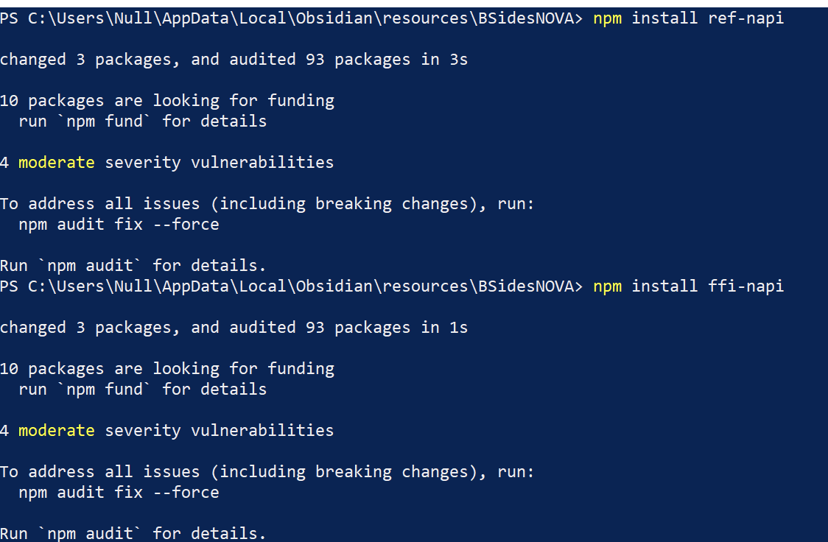
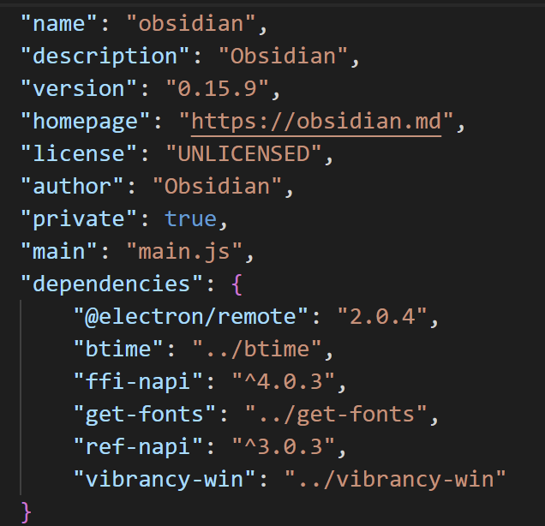
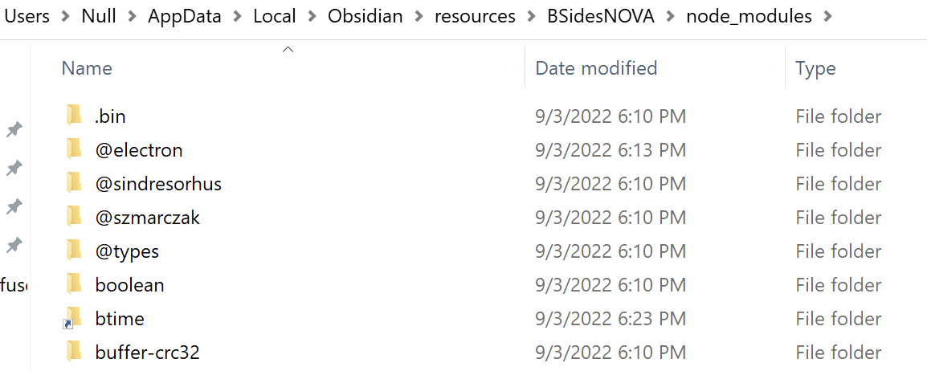
Install ref-napi and ffi-napi

Slide 30
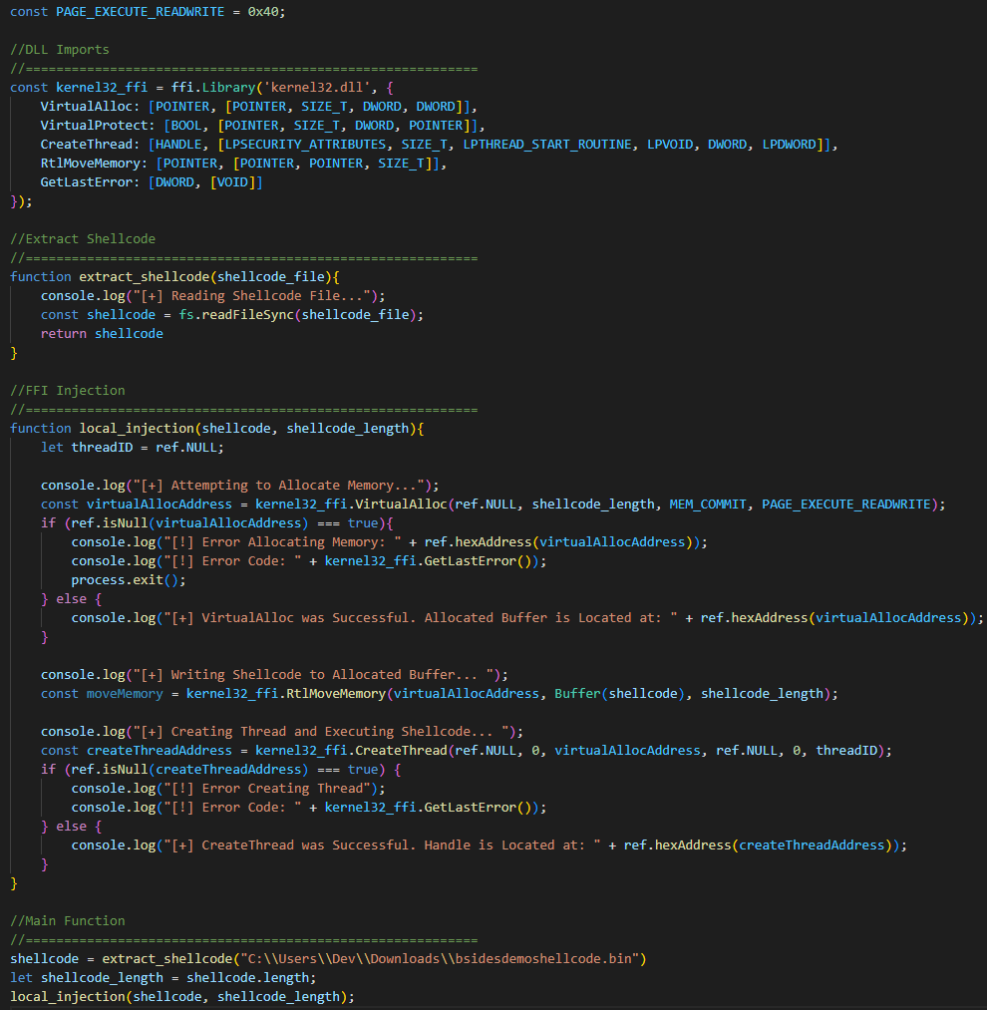
Modify Entry Point JavaScript file
Interfacing with Kernel32 functions
Extract Shellcode From Disk
Allocate Buffer using VirtualAlloc
Move Shellcode into Buffer using RTLMoveMemory
Create a Thread to Execute Shellcode using CreateThread

Slide 31
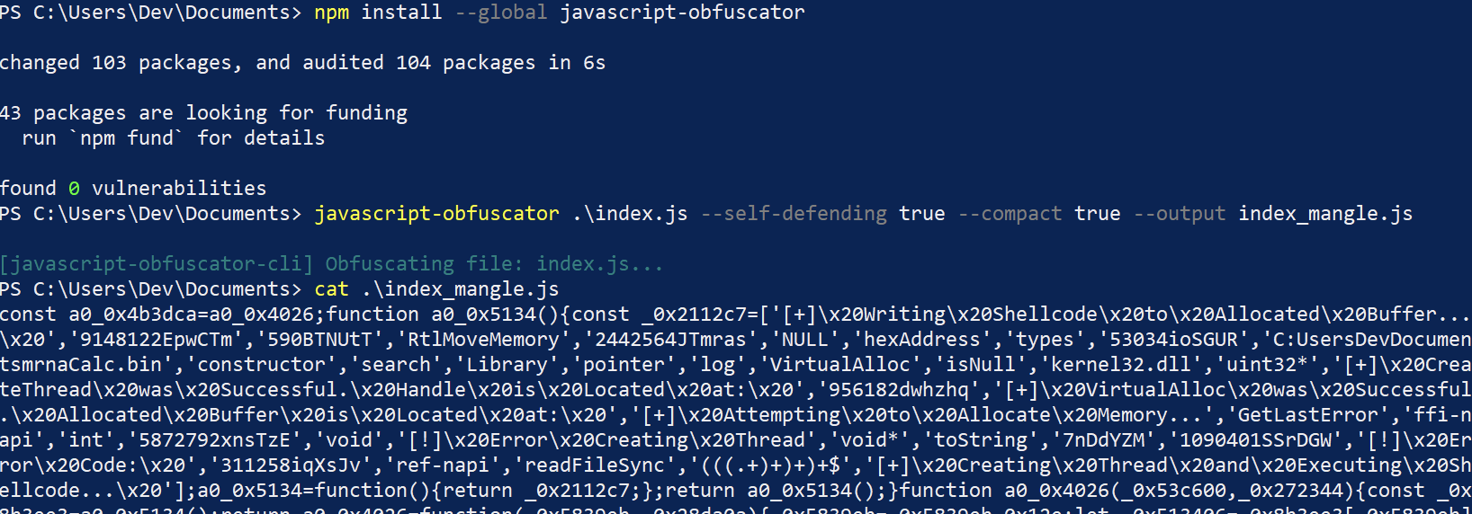
BONUS: OBFUSCATE LOADER
Install javascript-obfuscator
Obfuscate and Minify Loader

Slide 32
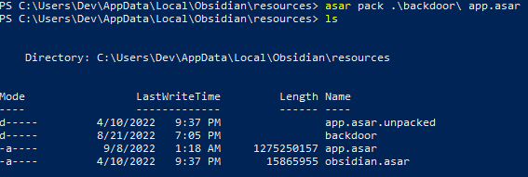
Pack the contents back into app.asar

Slide 33
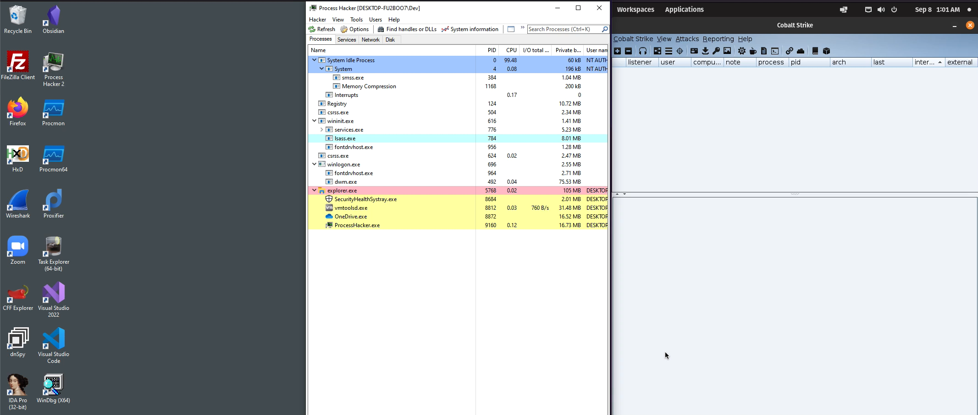
Demo

Slide 34

FFI BACKDOORING RESULTS
Pros:
Execute code in context of Electron application
Only requires low-privilege access
No PEs (DLLs/EXEs) used
Cons:
Difficult to initially set up

Slide 35
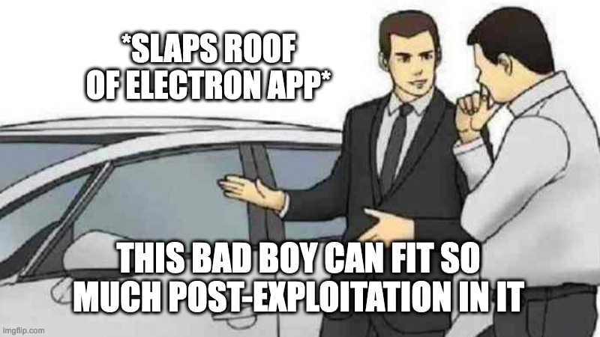
ADDITIONAL POST-EXPLOITATION IDEAS
Dumping Teams/Slack Session Cookies
Command-and-Control Agent
Venus Agent for Mythic Comes to Mind…
Prompting Users for Credentials
Local Persistence
Slack/Teams Run on Start Up…
Keylogger

Slide 36
04
CONCLUSION
Conclusion and Recommendations

Slide 37
Recommendations (For Application Developers)
INSTALL APPS AS HIGH PRIVILEGE USER
Requires an adversary to escalate local privileges before an Electron application can be abused
VERIFY ASAR INTEGRITY AT RUNTIME
ASAR integrity checking is supported on macOS. Windows does not currently support, but is in development

Slide 38
Recommendations Continued
DETECT SUSPICIOUS MODIFICATIONS OF ASAR FILES
Use host-based security product to alert on suspicious access to ASAR files from non-Electron processes
UPDATE TO LATEST ELECTRON VERSION
Updates often fix security vulnerabilities and update the underlying Chromium and Node.js versions

Slide 39
CONCLUSION
Electron is a widely used runtime framework used to build applications seen in most client environments
Electron exposes application source code within installation folder
This allows attackers to backdoor production Electron applications without breaking executable signature
Until Electron developers implement integrity checking on Windows, applications will be vulnerable to this abuse
Read more about this in my blog: https://barbellsandrootshells.com/electron-shellcode-loader

Slide 40
REFERENCES
https://www.electronjs.org/docs/latest/
http://man.hubwiz.com/docset/electron.docset/Contents/Resources/Documents/index.html
https://nodejs.org/en/docs/
Introducing Electron by Felix Rieseberg
https://www.contextis.com/en/blog/basic-electron-framework-exploitation
https://thevivi.net/blog/pentesting/2022-03-05-plugins-for-persistence/
https://www.infoq.com/articles/the_edge_of_net_and_node/
https://blog.doyensec.com/2018/07/19/instrumenting-electron-app.html
https://www.blackhat.com/docs/us-17/thursday/us-17-Carettoni-Electronegativity-A-Study-Of-Electron-Security.pdf

Slide 41
THANK YOU FOR LISTENING!
Presentation Template By: Slidesgo​

